Slide 1
Jermyn Borough Council Meeting
11/18/21

Slide 2

Meeting Agenda
November 18, 2021
CALL TO ORDER
PLEDGE OF ALLEGIANCE
ROLL CALL
PREVIOUS MEETING MINUTES(10/21/21)
TREASURER REPORT/BILLS PAYABLE
CORRESPONDENCE
PUBLIC COMMENT
PROFESSIONAL REPORTS
COMMITTEE REPORTS
CYBER INSURANCE
COUNTY REINVEST GRANT RESOLUTION
LSA GRANT RESOLUTION
RIGHT TO KNOW OFFICER
CIVIL SERVICE
2022 BUDGET

Slide 3
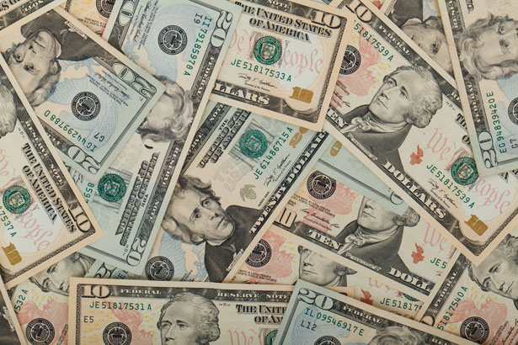
Treasurer’s report
11/18/21
ASSETS
Checking/Savings
Capital Reserve - DPW 10,725.40
Capital Reserve - Police 4,516.82
Crime Watch Fund 222.69
General Fund - Community 101,610.35
General Fund - FNB 4,295.02
Holiday Lights Fund 940.14

Slide 4
Treasurer’s report
Investment - General Fund 1,001.58
Investment - Liquid Fuels 33,815.77
Investment - Paving Fund 1,011.94
Investment - Recycling 5,003.67
Investment - Refuse 2,600.35
Liquid Fuels - FNB 25,366.57
Petty Cash 231.00
Recreations Fund 15,939.25
Recycling - Community 8,673.76
Refuse Checking - FNB 66,851.83
Total Checking/Savings 282,806.14

Slide 5
Treasurer’s report
200000 · Accounts Payable 52,797.84

Slide 6
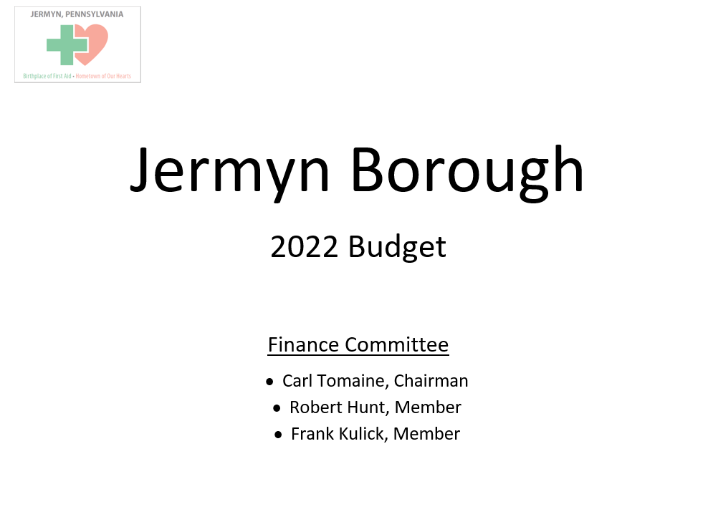

Slide 7
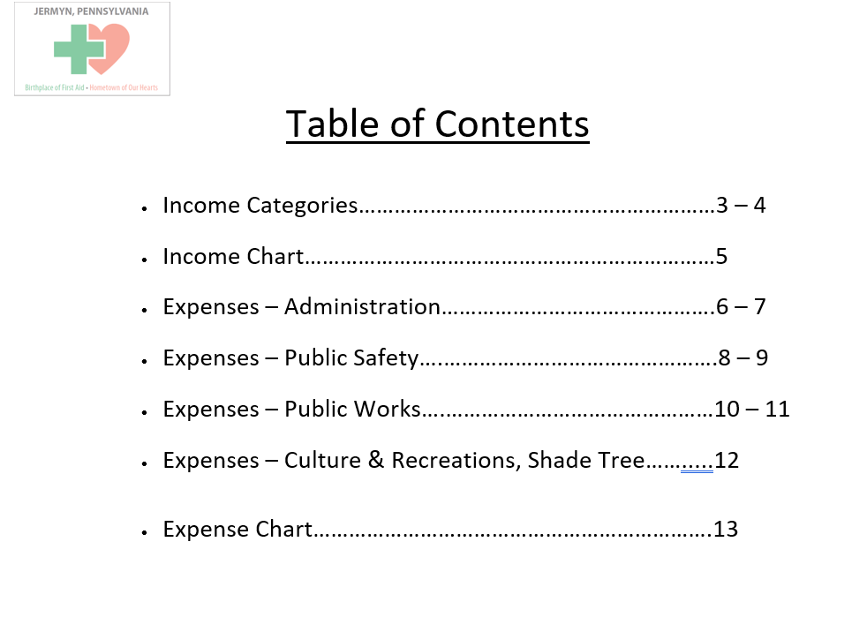

Slide 8
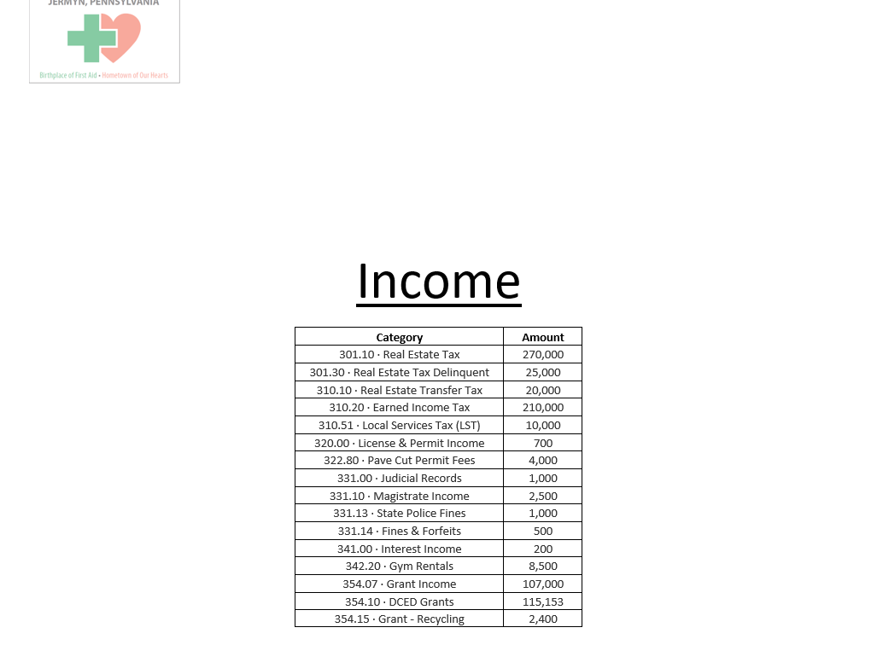

Slide 9
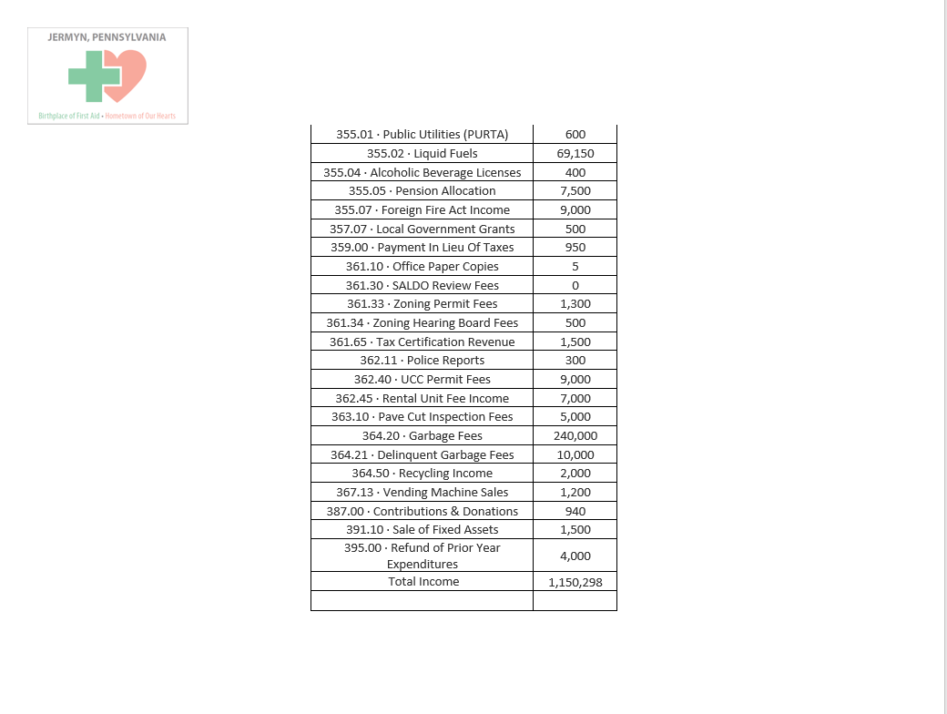

Slide 10
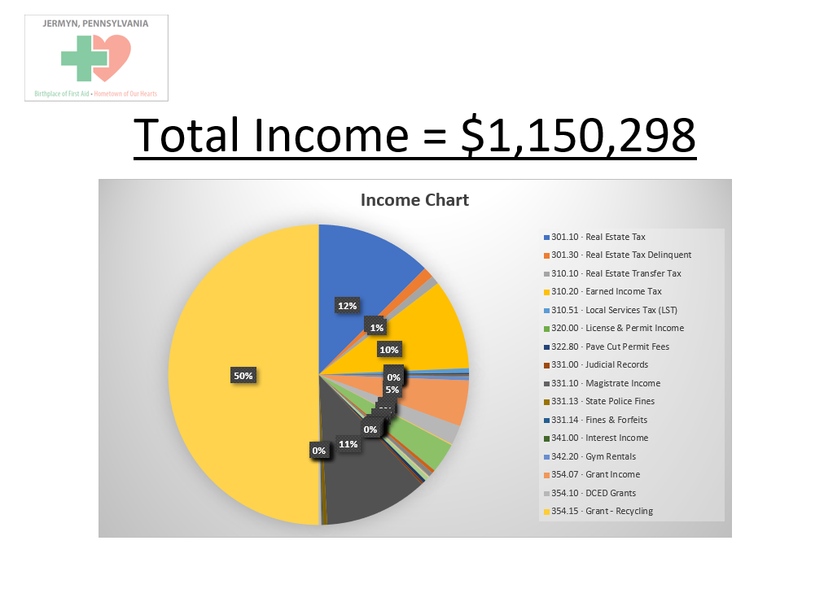

Slide 11
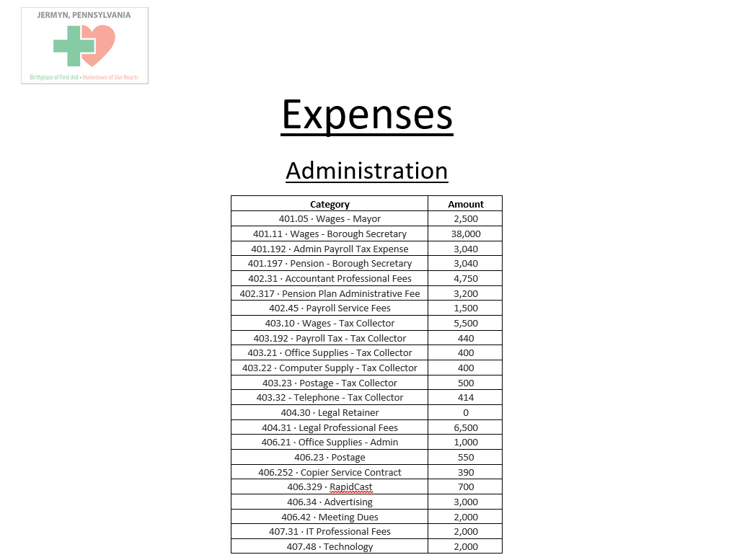

Slide 12
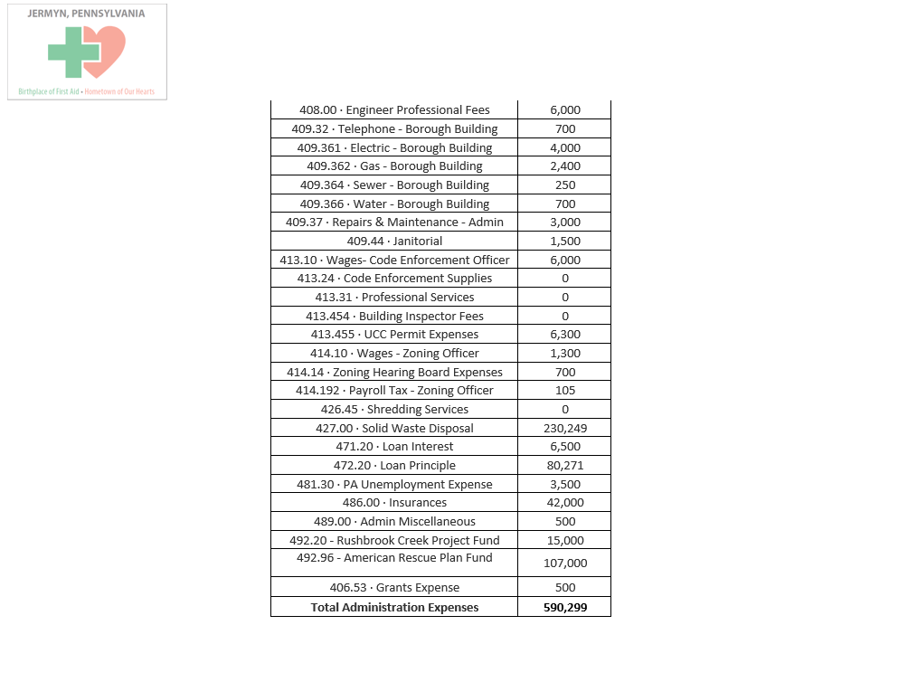

Slide 13
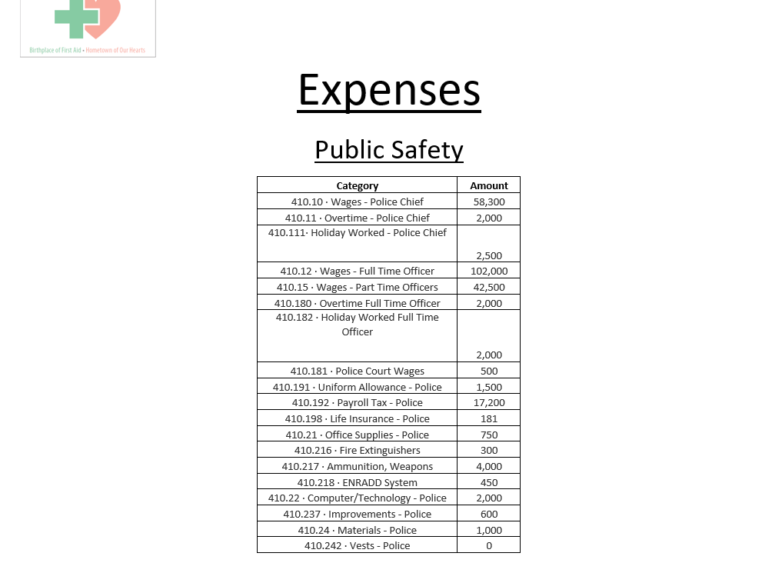

Slide 14
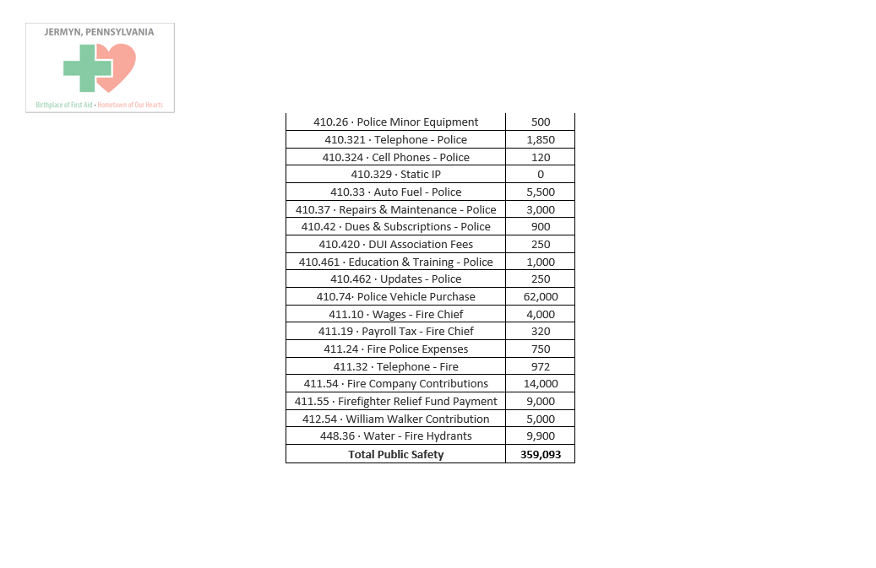

Slide 15
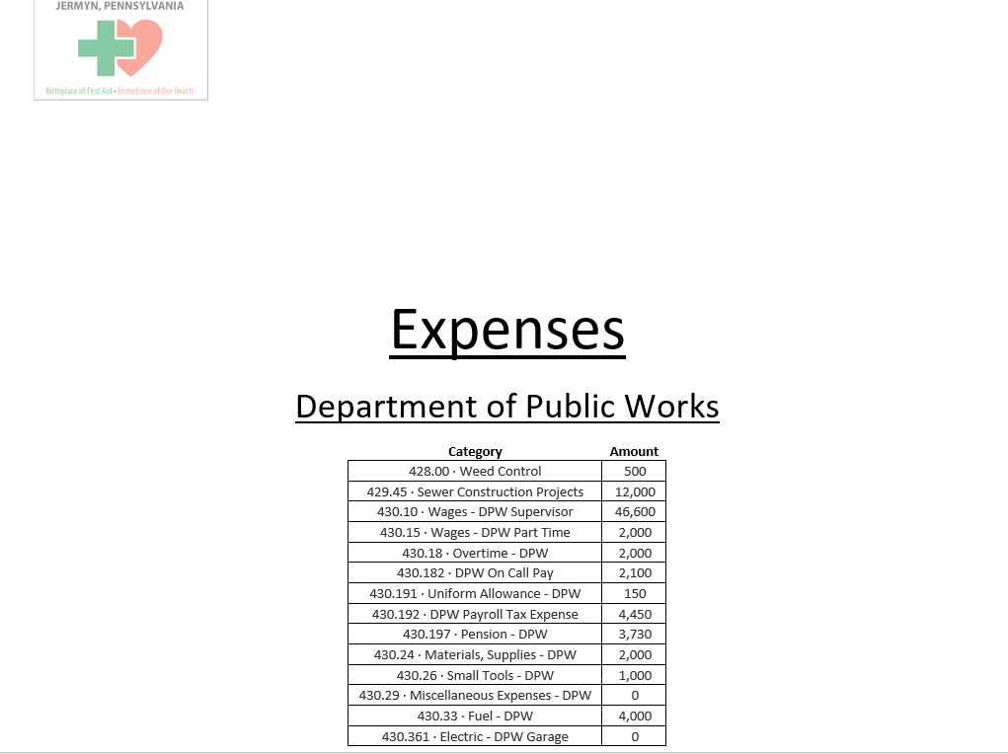

Slide 16
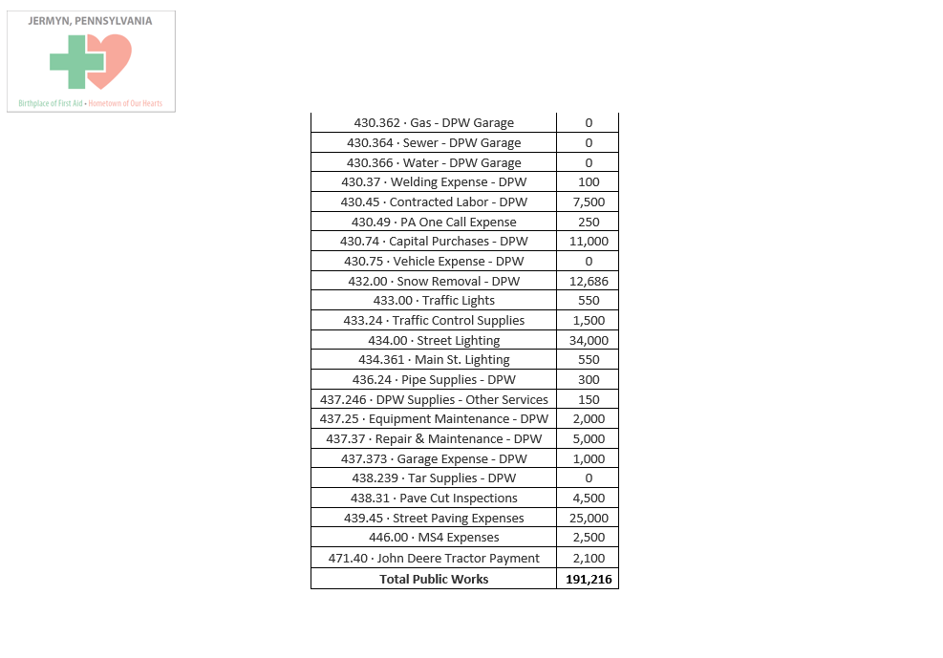

Slide 17
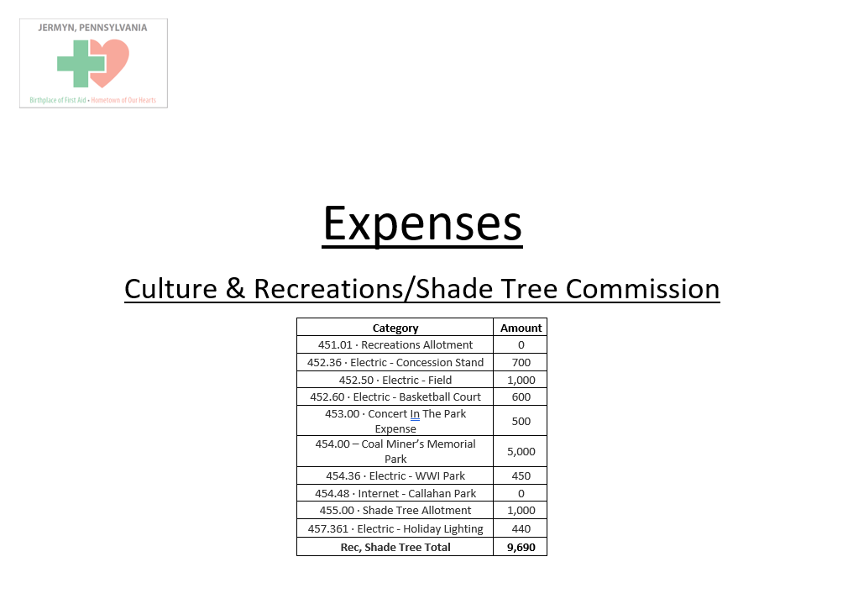

Slide 18
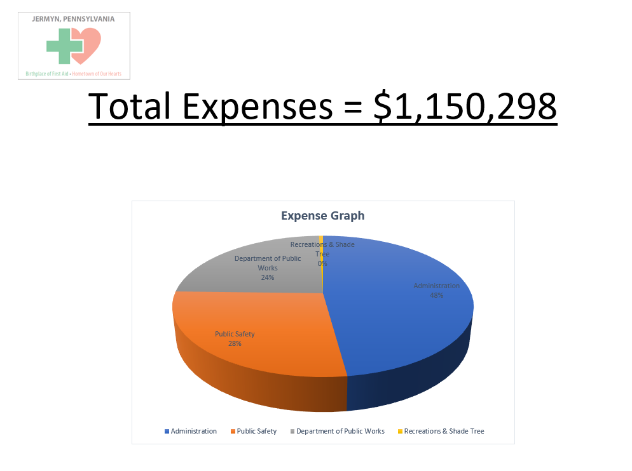

Slide 19


